Slide 1
Cosc 3P94
Introduction
Stevie made a deal with the devil. Nobody knows what Stevie got, but the devil got guitar lessons﻿. (In reference to guitar legend Stevie Ray Vaughan.)
Scott Hufford

Slide 2
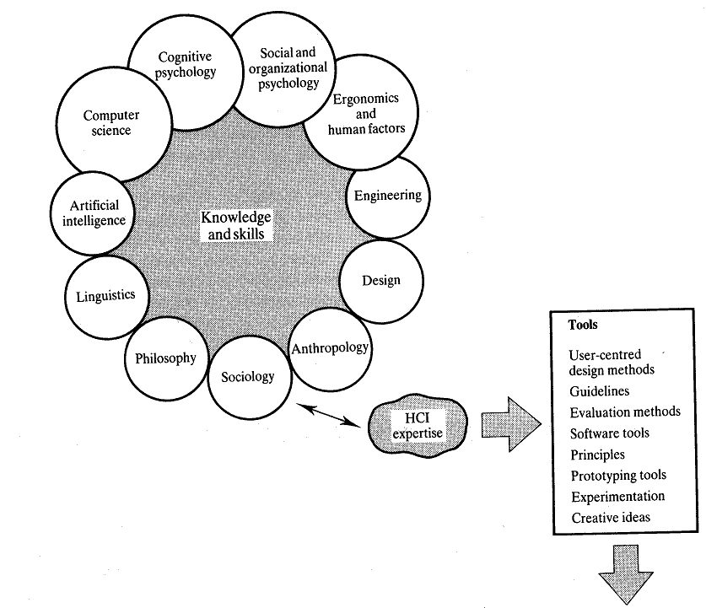
Components of HCI

Slide 3
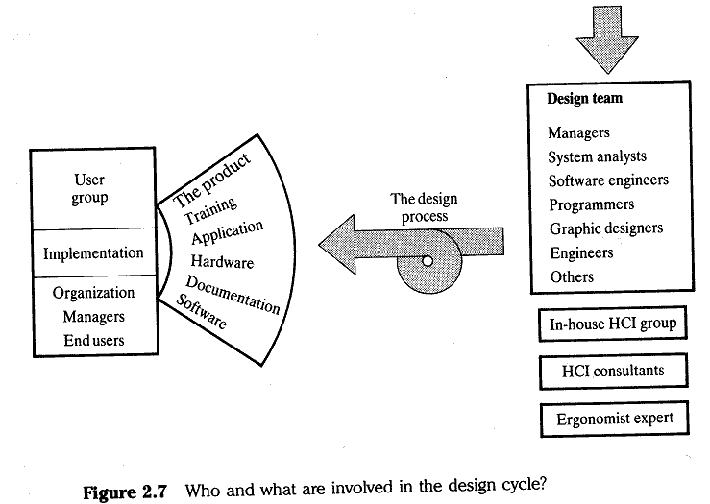
Components of HCI

Slide 4
Homo Sapiens vs. Homo Logicus
Like Simplicity
Like Success
  Goal minded
Focus on what is probable
  What is realistic
Doesn’t care about internals
Doesn’t really know or care about how the “thing” works, just that it will achieve their goal.
View s/w as a tool.
Normal, whatever that means.
Like Control
  Like Features
Like Understanding
  Inner workings
Focus on what is possible
  Edge Cases
Willing to invest time and energy to learn the system
Masters of knowledge
  Obsessive
  Technically proficient
View the s/w as a personal challenge.
Technical Jocks

Slide 5
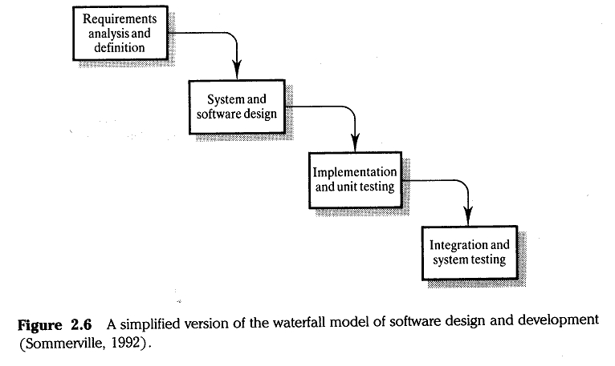
Simplified Water Fall Model

Slide 6
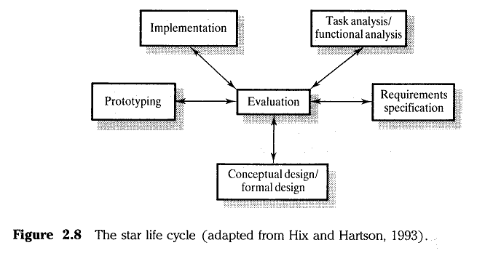
Star Life Cycle

Slide 7
Example
Physical aspects of the design, for a workspace for someone who does word processing type tasks for 7 1/2 hrs. Per day.
Goals - physical comfort
- alertness
- efficiency, error rates, etc.
Problems - keyboard height
- distance from eye to screen
- screen illumination, brightness, contrast, focus
on work area
- workspace organisation, space for paper, etc.
- fatigue
Who’s goals are these?

Slide 8
Example Continued
How subtle can the problem get?
· Will use of the keyboard AND a mouse be effective?
· If the user employs a mouse, then he/she will have to remove his/her hands from the keyboard
con - time taken to reposition hands is a waste of time.
pro - movement, change of posture, etc. may ease muscle tension and improve alertness
Cost of implementation?
Who Benefits
  Worker?
  Management?
    What are the goals of management.

Slide 9
Human Factors in Software
“The budget and most of the schedule have already been expended, and the option of throwing away much or all of the design and the completed code makes the project managers look bad. Even so, as recent a book on project management as the UML Toolkit (Eriksson and Magnus 1998) fails to recognise that the interface has to be part of the requirements analysis, which is Eriksson and Magnus’s first phase of the project development. Contrary to their suggestion, interface design cannot be postponed until the technical design phase (their third phase). Once the product’s task is known, design the interface first; then implement to the interface design. This is an iterative process: The task definition will change as the interface is designed, and the implementation will be influenced by the task definition and the interactive design as well. Flexibility on all fronts is needed. The place to start the implementation is to list exactly what the user will do to achieve his or her goals and how the system will respond to each user action.” (Jef Raskin, The Humane Interface, page 5)

Slide 10
End

